Slide 1
Complexity Analysis
(For reading)

Slide 2
Objectives
Computational and Asymptotic Complexity
Big-O, Big-Ω and Big-Θ Notations
The Best, Average, and Worst Cases
NP-Completeness

Slide 3
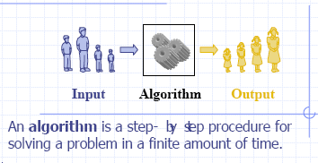
Simple definition of an algorithm

Slide 4
Analysis of Algorithms
What are requirements for a good algorithm?
Precision:
Proved by mathematics
Implementation and test
Simple and public
Effectiveness:
Run time duration (time complexity)
Memory space (space complexity)

Slide 5
What is a computational complexity?
The same problem can be solved with various algorithms that differ in efficiencies.
The computational complexity (or simply speaking, complexity) of an algorithm is a measure of how “complex” the algorithm is. The complexity answers the question: How difficult is to compute something that we know to be computable?
e.g. What resources (time, space, machines, ...) will it take to get a result?
Rather than referring to how “complex” an algorithm is, we often talk instead about how “efficient” the algorithm is. Measuring efficiency (or complexity) allows us to compare one algorithm to another (assuming that both algorithms compute the same result).
There are several measurements to compare algorithms. Here we’ll focus on one complexity measure: the computation time of an algorithm.
How can we compare program execution on two different machines? For example, if we use wall clock time to compare two different machines, will this tell us which algorithm/program is more efficient?

Slide 6
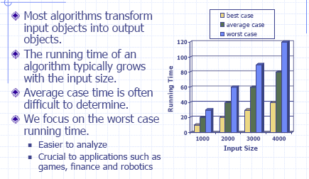
Running time

Slide 7
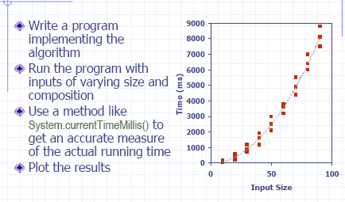
Experimental Studies

Slide 8
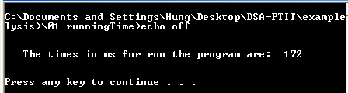
Experimental Study Example
import java.util.Calendar;
public class Main
{ public static void main(String[] args)
{ long beginTimes = Calendar.getInstance().getTimeInMillis();
long n = 10000;
for (long i=0; i<n;++i)
for(long j =0; j<n; ++j);
long endTimes = Calendar.getInstance().getTimeInMillis();
System.out.println("The times in ms for run the program are:");
System.out.println(endTimes - beginTimes);
}
}

Slide 9
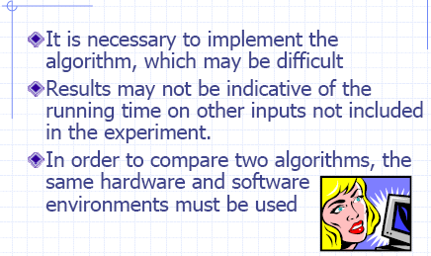
Limitations of Experiments

Slide 10
Time complexity of an algorithm (1)
Run time duration of a program depend on
Size of data input
Computing system (platform: operation system, speed of CPU, type of statement…)
Programming languages
State of data
=> It is necessary to evaluate the run time of a program such that it does not depend on computing system and programming languages.

Slide 11
Time complexity of an algorithm (2)
We’ll define a time complexity measure as the number of operations performed by the algorithm on an input of a given size.
What is meant by “number of operations”?
and
What is meant by “size”?
We want to express the number of operations performed as a function of the input size n.
What if there are many different inputs of size n?
Worst case
Best case
Average case
“number of operations” = “running time”?

Slide 12
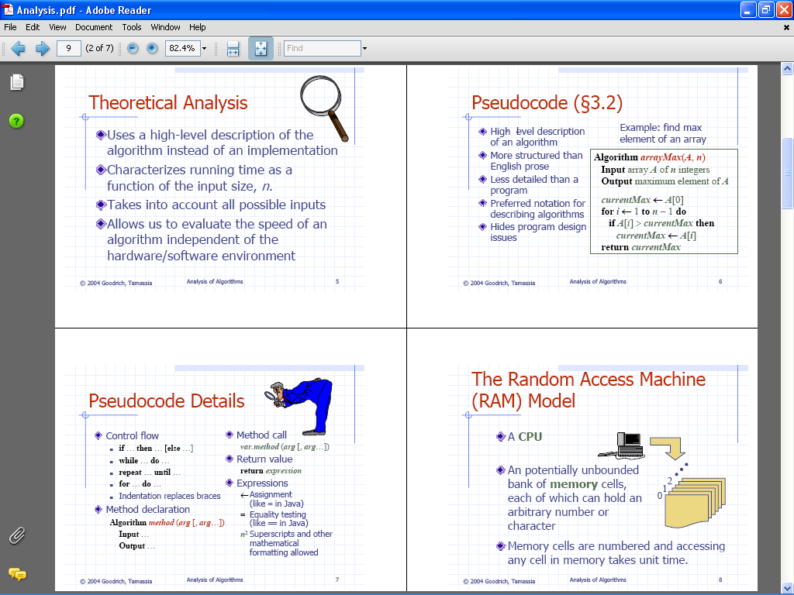

Slide 13
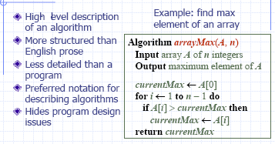
Pseudocode

Slide 15
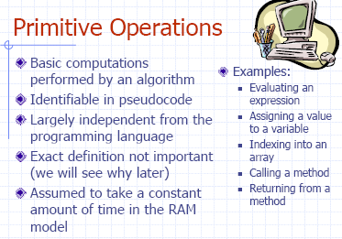

Slide 16
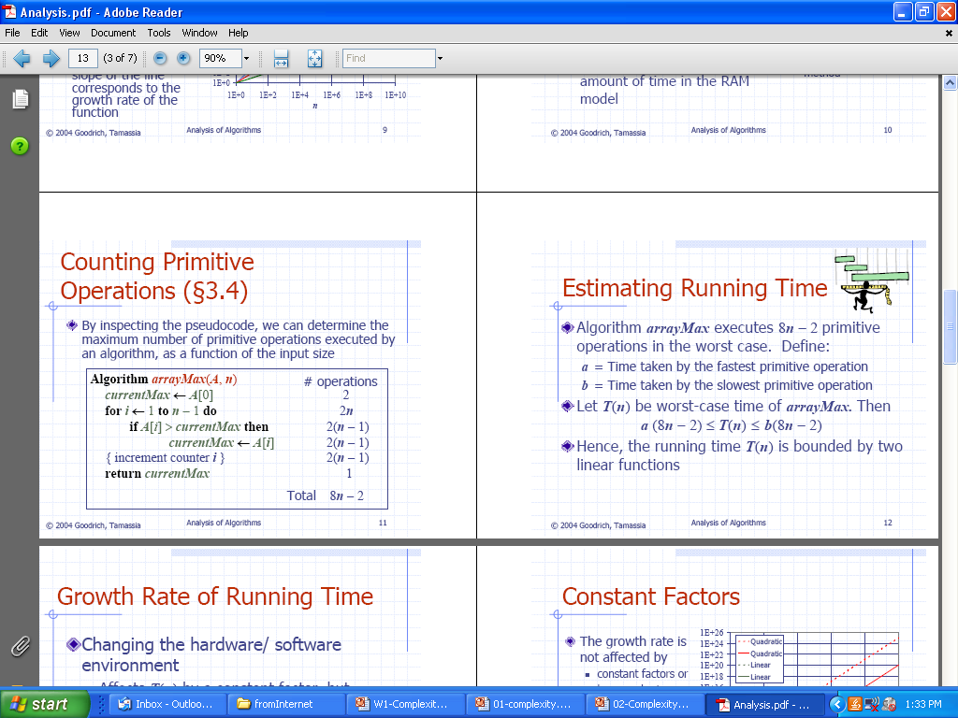
Counting Primitive Operation

Slide 18
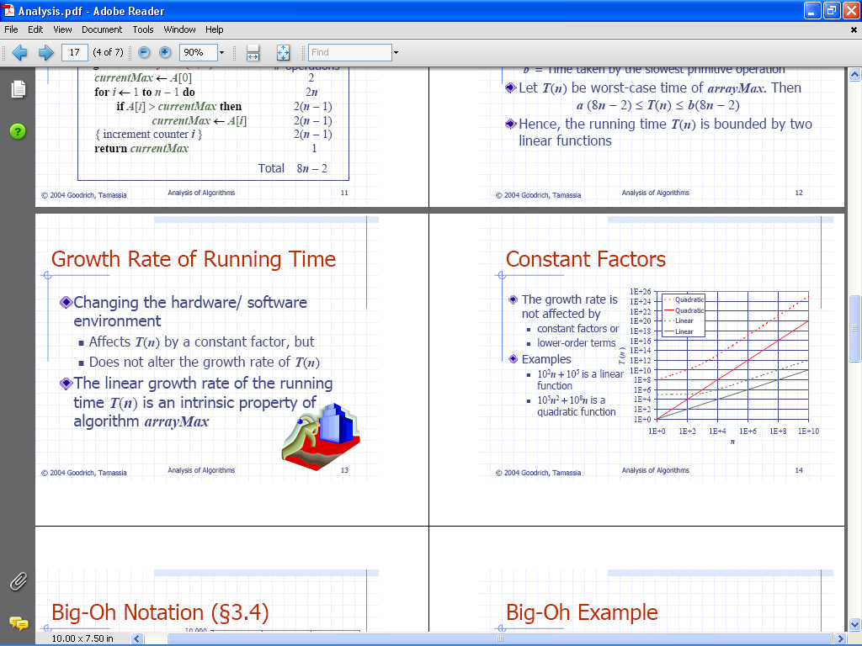

Slide 20
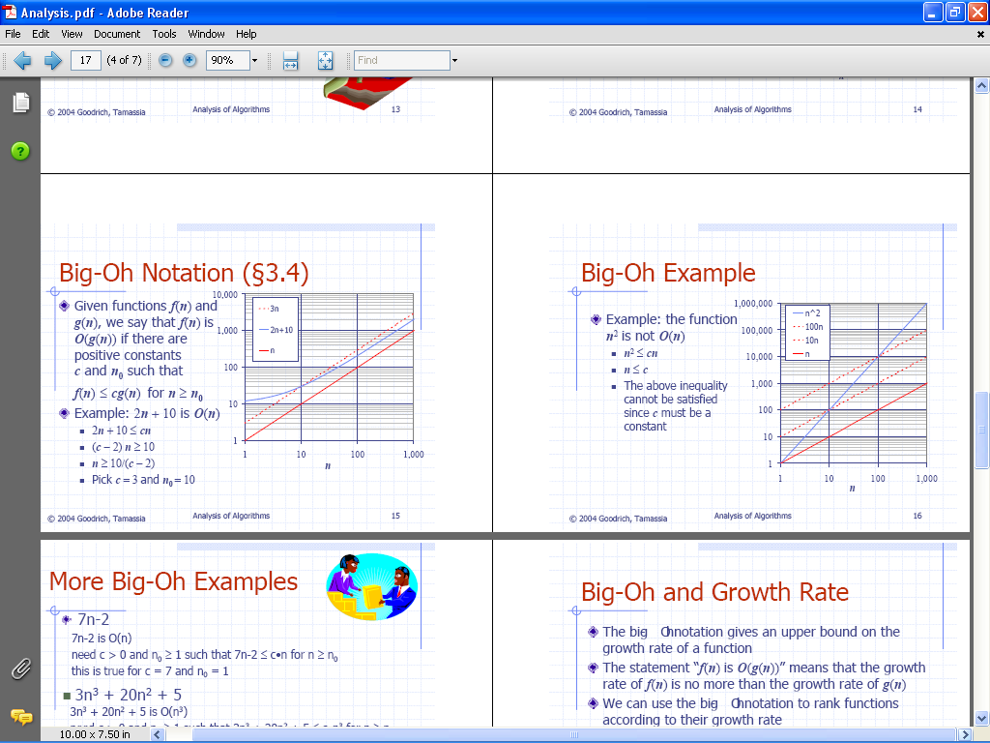
Big-Oh Notation
Big O notation is also called Big Oh notation, Landau notation, Bachmann–Landau notation, and asymptotic notation. A description of a function in terms of big O notation usually only provides an upper bound on the growth rate of the function; associated with big O notation are several related notations, using the symbols o, Ω, ω, and Θ, to describe other kinds of bounds on asymptotic growth rates.

Slide 21
big-oh notation pronouncement :
O(1) : O to the one O(n) : O to the n, Big-O of n
O(log₂ n): O to the log₂ n

Slide 22
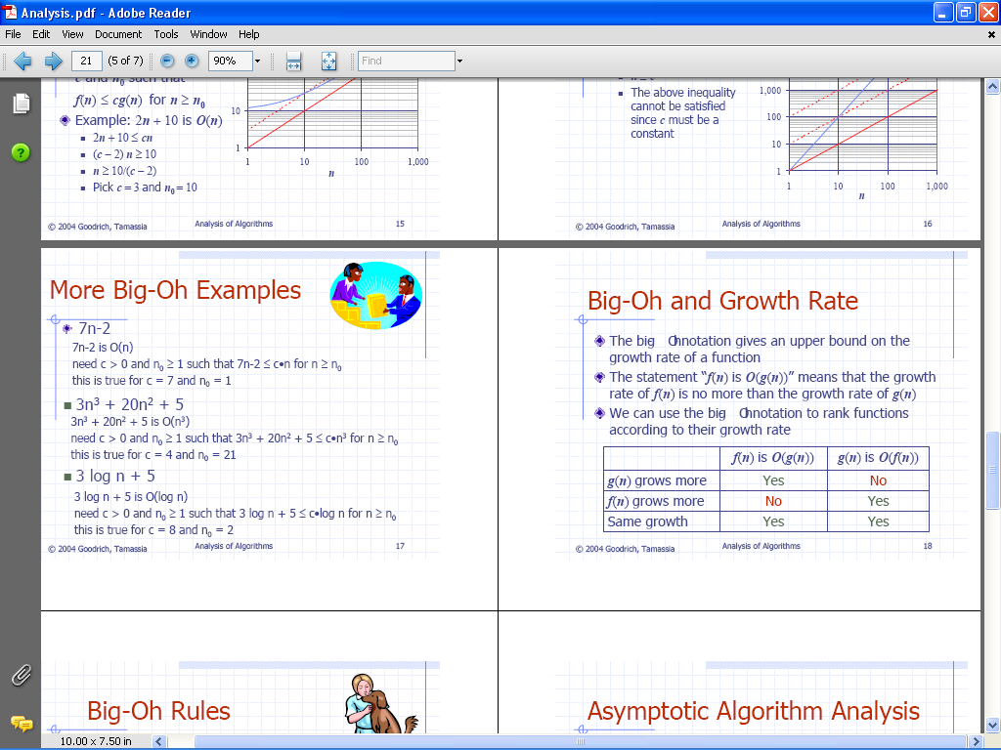

Slide 23
When we say that f(n) is O(g(n)), we use g(n) to provide a limit as to how fast f(n) can grow when n goes to infinity.

Slide 24
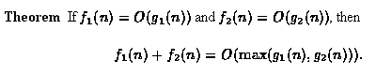
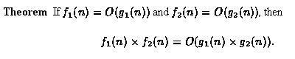
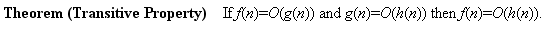
Properties of Big-Oh
The first theorem addresses the asymptotic behavior of the sum of two functions whose asymptotic behaviors are known:
The next theorem addresses the asymptotic behavior of the product of two functions whose asymptotic behaviors are known:
The last theorem in this section introduces the transitive property of big oh:

Slide 25
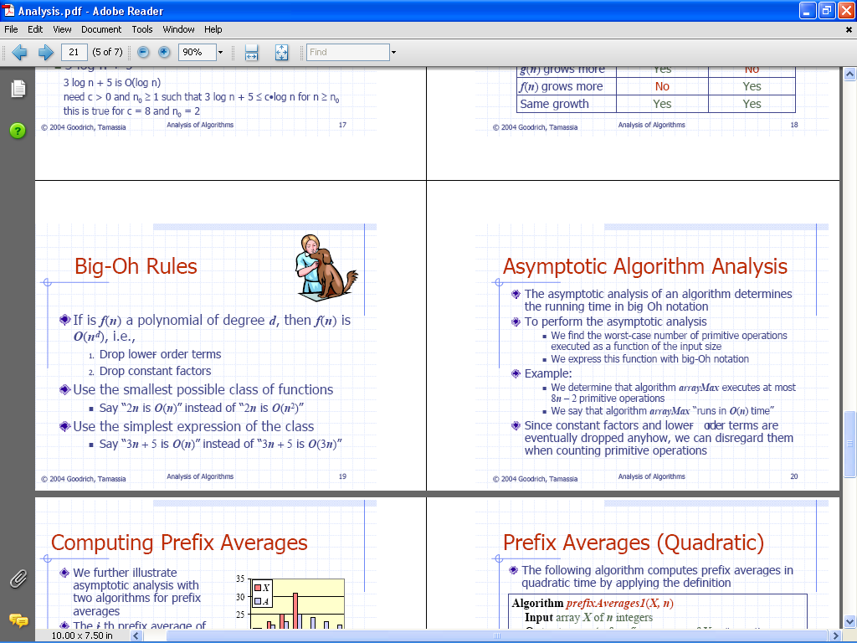

Slide 27
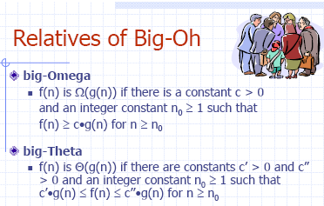

Slide 28
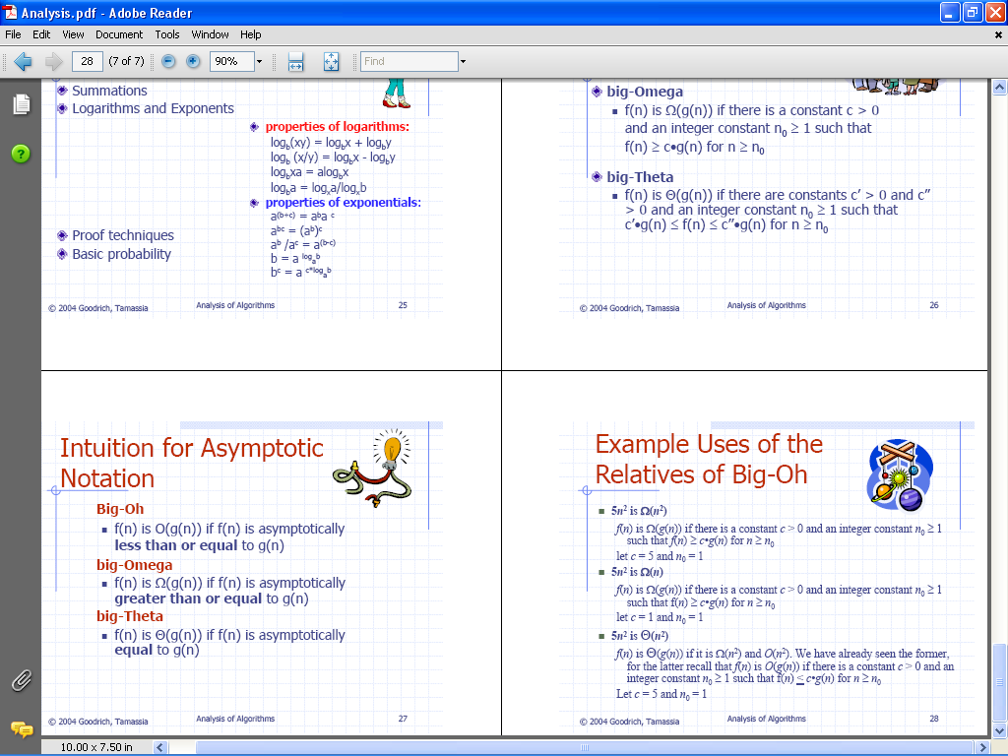

Slide 30
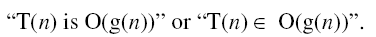
More notes about Big-Oh notation
Using Big-O notation, we might say that “Algorithm A runs in time Big-O of n log n”, or that “Algorithm B is an order n-squared algorithm”. We mean that the number of operations, as a function of the input size n, is O(n log n) or O(n²) for these cases.
Notes about style: We write
Both of these expressions are better than writing
“T(n) = O(g(n))”.
Some authors use the latter, but the first two choices are preferred.

Slide 31
Some common growth orders of functions
To express O(), we often use the following functions:
constant | O(1)
logarithmic | O(logn)
linear | O(n)
nlogn | O(nlogn)
quadratic | O(n²)
polynomial | O(n^{b})
exponential | O(b^{n})
factorial | O(n!)

Slide 32
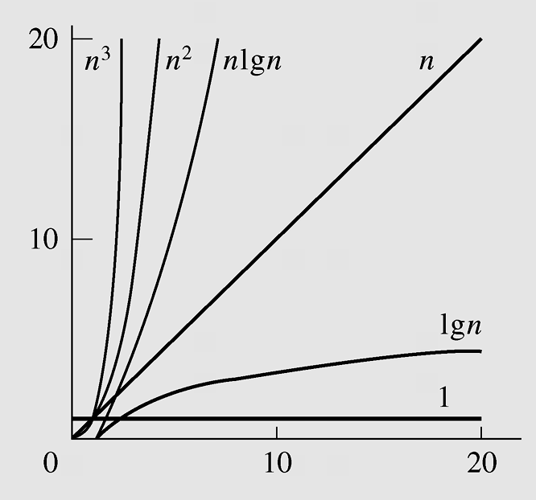
Growth orders of functions in graphics
Typical functions applied in big-O estimates

Slide 33
Binary Search vs Sequential Search
Find method
Sequential
Worst case time: c₁ n
Binary search
Worst case time: c₂ log₂n
Small
problems -
we’re not
interested!
n
Large
problems -
we’re
interested
in this gap!
4log₂n
Binary search
More complex
Higher constant factor

Slide 34
Determining time complexity
To determine time complexity:
• Count operations, and
• Convert to big-Oh notation.
We will use “pseudocode” to describe algorithms.

Slide 35
Examples for determining time complexity - 1
max returns the maximum element in a sequence.
procedure max(a₀ ,a₁, a₂, . . . , a_{n}: R)
max := a₀
for i := 1 to n
if max < a_{i} then max := a_{i}
end for
return max
end procedure
The comparison max < a_{i} is performed n − 1 times.
n − 1 is O(n).

Slide 36
Examples for determining time complexity - 2
Linear search returns the location of key in a sequence, or -1 if key is not in the sequence.
procedure linear search (key, a₀, a₁, . . . , a_{n}: R)
loc := -1
i := 0
while i <= n and loc = -1
if key = a_{i} then loc := i
i := i + 1
return loc
The comparison key = a_{i} is performed from 1 to n times.
Both 1 and n are O(n).

Slide 37
Examples for determining time complexity - 3
Binary search returns the location of key in a sorted sequence, or -1 if key is missing.
procedure binary search (key: R; a₀, a₁, . . . , a_{n}: increasing R)
left := 0; right := n-1
while left <= right
begin
mid := (left + right)/2
if a_{mid} = key return mid
if key > mid
then left := mid + 1
else right := mid -1
end
return -1
key > amid is performed log2 n times. O(log2 n).

Slide 38
Amortized Complexity – Main idea
Worst case analysis of run time complexity is often too pessimistic. Average case analysis may be difficult because:
it is not clear what is “average data",
uniformly random data is usually not average,
probabilistic arguments can be difficult.
Amortized complexity analysis is a different way to estimate run times. The main ideas is to spread out the cost of operations, charging more than necessary when they are cheap – thereby “saving up for later use" when they occasionally become expensive.

Slide 39
Amortized Complexity...
Worst case:
C(op₁, op₂, op₃, . . .) = C_{worst}(op₁) + C_{worst}(op₂) + C_{worst}(op₃) + . . .
Average case:
C(op₁, op₂, op₃, . . .) = C_{avg}(op₁) + C_{avg}(op₂) + C_{avg}(op₃) + . . .
Amortized:
C(op₁, op₂, op₃, . . .) = C(op₁) + C(op₂) + C(op₃) + . . .
Where C can be worst, average, or best case complexity

Slide 40
Amortized Complexity...
Consider the operation of adding a new element to a flexible array a. Suppose number of elements in a is count, and the size of a is N. If count<N then the cost of the operation is O(1). If count=N then at first we should create new array with size = N + k and copy all elements on a to the new array and then add new element to new array. Copying all elements from a to new array costs O(count). If k=1 then after the first overflow, each insertion causes overflow and cost O(count). Clearly, this situation should be delayed. One solution is to double the space allocated for the array if overflow occurs. It may be claimed that, in the best case, the cost of inserting m items is O(m), but it is impossible to claim that, in the worst case, it is O(m*count). Therefore, to see better what impact this performance has on the sequence of operations, the amortized analysis should be used.
In amortized analysis, the question is asked: What is the expected efficiency of a sequence of insertions? We know that the best case is O(1) and the worst case is O(count), but also we know that the latter case occurs only occasionally and leads to doubling the size of the array. In this case what is the expected efficiency of one insertion in the series of insertions? We are interested in sequences of insertions to have the worst case senario. The outcome of amortized analysis depends on the assumed amortized cost of one insertion amCost(add(x)). It is clear that we cannot simply take amCost(add(x)=1, because it does not consider the overflow case. In general it is not adequate to choice constant k for amortized cost (i.e. amCost(add(x)=k). Define as potencial a function that assigns a number to a particular state of a data structure ds that is a subject of a sequence of operations. The amortized cost is defined as a function:
amCost(op_{i}) = Cost(op_{i}) + potencial(ds_{i}) - potencial(ds_{i-1})
which is the real cost of executing the operation op_{i} plus the chage in potencial in the data structure ds as a result of execution of op_{i} . (potencial(ds_{i}) = 0 if count_{i} = N_{i} and 2count_{i} - N_{i} otherwise).
In our case, it can be proved that amCost(add_{i}() = 3.

Slide 41
NP - Completeness

Slide 42
What is NP problem?
The subject of computational complexity theory is dedicated to classifying problems by how hard they are. There are many different classifications; some of the most common and useful are the following.
P. Problems that can be solved in polynomial time. ("P" stands for polynomial.) These problems have formed the main material of this course.
NP. This stands for "nondeterministic polynomial time" where nondeterministic is just a fancy way of talking about guessing a solution. A problem is in NP if you can quickly (in polynomial time) test whether a solution is correct (without worrying about how hard it might be to find the solution). Problems in NP are still relatively easy: if only we could guess the right solution, we could then quickly test it.
unsolved problem: P=NP?

Slide 43
Reduction (1)
Formally, NP-completeness is defined in terms of "reduction" which is just a complicated way of saying one problem is easier than another. We say that A is easier than B, and write A < B, if we can write down an algorithm for solving A that uses a small number of calls to a subroutine for B (with everything outside the subroutine calls being fast, polynomial time). There are several minor variations of this definition depending on the detailed meaning of "small" -- it may be a polynomial number of calls, a fixed constant number, or just one call.
Then if A < B, and B is in P, so is A: we can write down a polynomial algorithm for A by expanding the subroutine calls to use the fast algorithm for B.
So "easier" in this context means that if one problem can be solved in polynomial time, so can the other. It is possible for the algorithms for A to be slower than those for B, even though A < B.

Slide 44
Reduction (2)
As an example, consider the Hamiltonian cycle problem. Does a given graph have a cycle visiting each vertex exactly once? Here's a solution, using longest path as a subroutine:
for each edge (u,v) of G
if there is a simple path of length n-1 from u to v return yes // path + edge form a cycle
return no
This algorithm makes m calls to a longest path subroutine, and does O(m) work outside those subroutine calls, so it shows that Hamiltonian cycle < longest path. (It doesn't show that Hamiltonian cycle is in P, because we don't know how to solve the longest path subproblems quickly.)

Slide 45
What is a NP-complete problem?
We are now ready to formally define NP-completeness.
We say that a problem A in NP is NP-complete when
1. It is NP
2. For every other problem B in NP, B < A.
This seems like a very strong definition. After all, the notion of reduction we've defined above seems to imply that if B < A, then the two problems are very closely related; for instance Hamiltonian cycle and longest path are both about finding very similar structures in graphs. Why should there be a problem that closely related to all the different problems in NP?
Cook's theorem: an NP-complete problem exists.

Slide 46
How to prove NP-completeness in practice
It is easily to prove that if A < B and B < C, then A < C.
As a consequence of this observation,
if A is NP-complete, B is in NP, and A < B, B is NP-complete.
In practice that's how we prove NP-completeness: We start with one specific problem that we prove NP-complete, and we then prove that it's easier than lots of others which must therefore also be NP-complete.
So e.g. since Hamiltonian cycle is known to be NP-complete, and Hamiltonian cycle < longest path, we can deduce that longest path is also NP-complete.

